Slide 1









Travel Mate – Map It. Plan It. Share It.
BY: STEPHANIE BUFFOTOT
Plan. Pin. Personalize Your Journey.
Create your dream trip

Slide 2




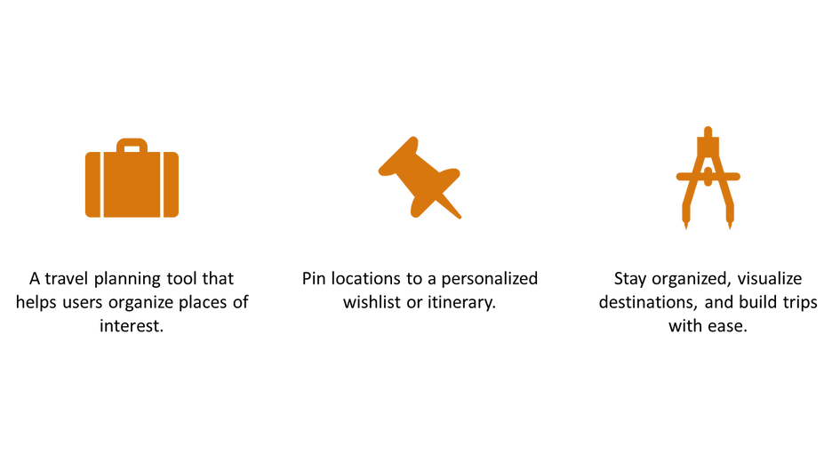

Welcome To Your Dream Vacation
About Us

Slide 3


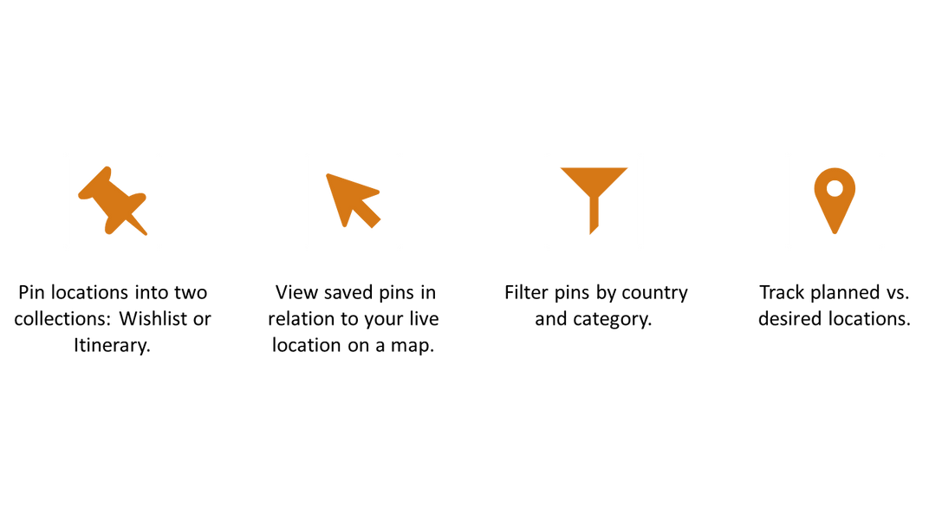

Core Features
Be your Own Travel Agent

Slide 4



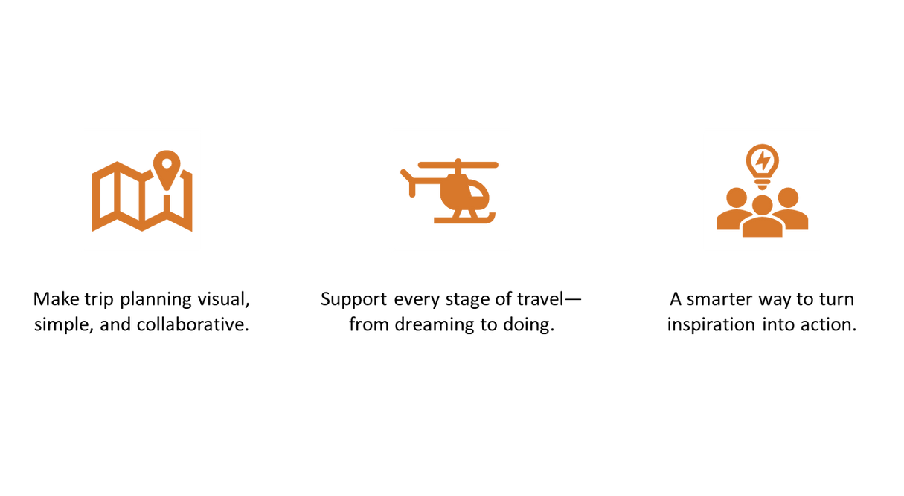


The Vision

Slide 5





Map Interaction
Live map shows your current position alongside saved pins.
Helps users navigate, explore, and understand proximity.
Future: Tap on pins to get real-time directions.

Slide 6




Wishlist vs. Itinerary
VS
Wishlist
Itinerary
Future travel ideas, dream spots, long-term goals
Confirmed trip plans sorted by city and category
Easily switch and edit pins between the two views.

Slide 7


Technical Stack
Summary
01
03
Built with Angular + Ionic for cross-platform support.
Backend handles pin storage, user data, and collections.
02
04
Modular pages: Add Location, Search, Map, Wishlist, Itinerary.
Uses Google Maps API for real-time geolocation & search.
Learn More

Slide 8
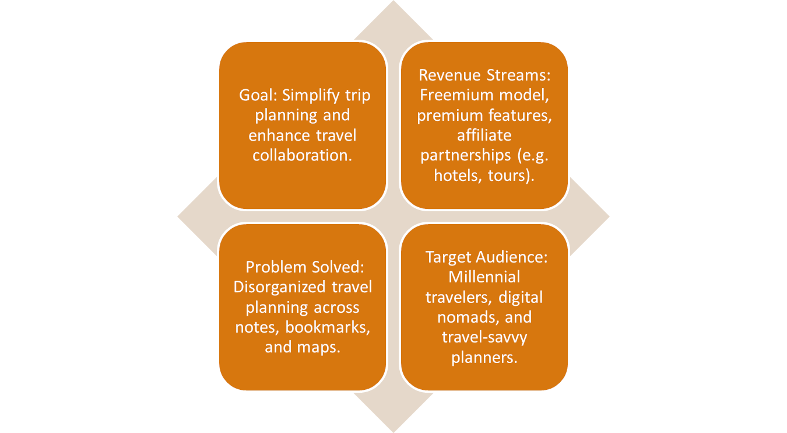
Business Aspects of the Product

Slide 9



Understanding Product Logic
Users pin locations → Sorted into Wishlist or Itinerary.
Each entry tied to country/category → Enables filtering.
Map page displays real-time location + pins → Increases engagement.
Sharing features → Network-driven growth via collaboration.
Auto-itinerary (future) → Personalized recommendations = user retention.

Slide 10



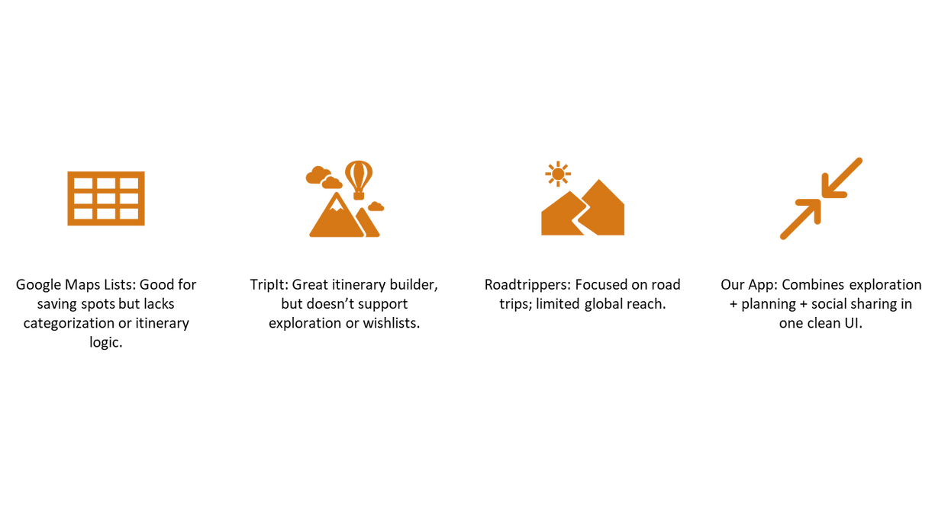
Understanding Product Logic

Slide 11



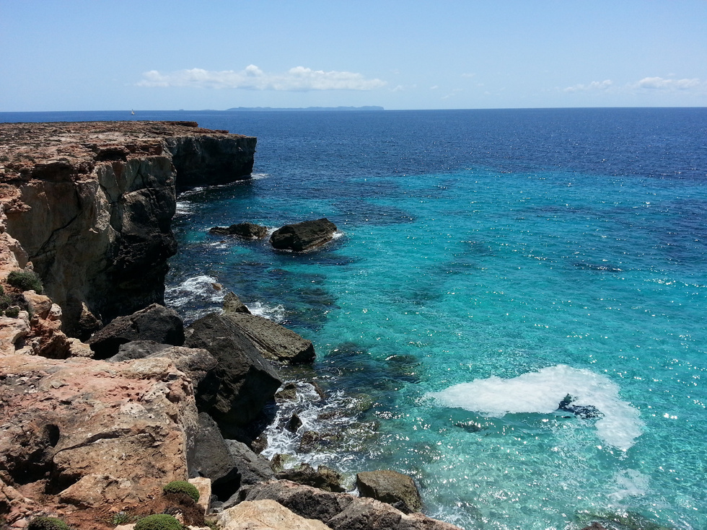




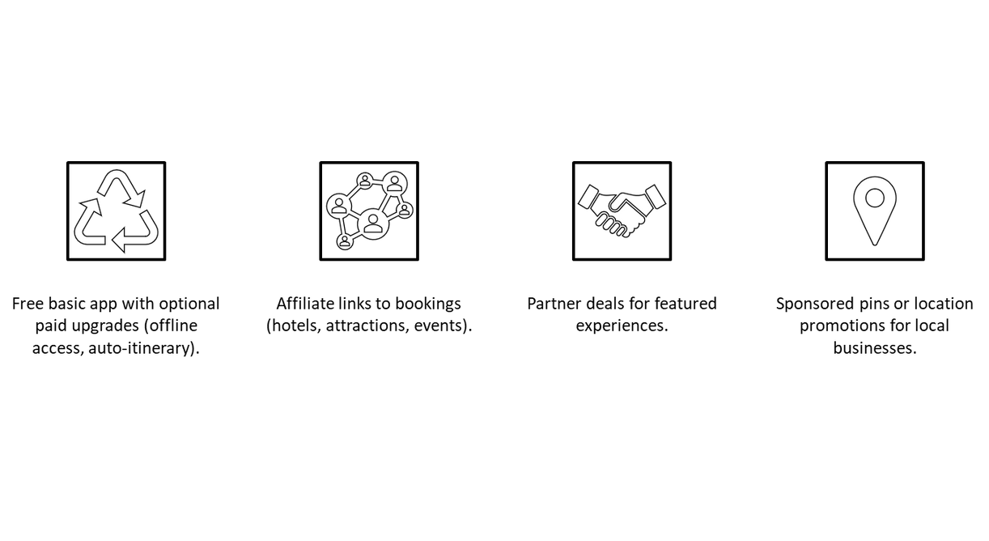
How Could This Product Make Money?

Slide 12

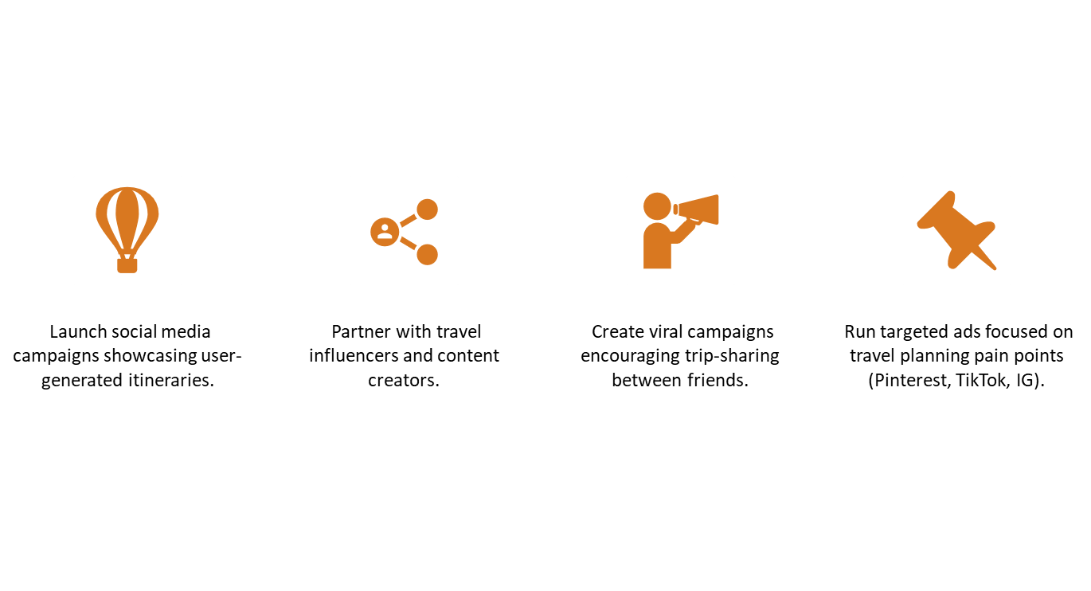

Marketing & Sales Strategy

Slide 13



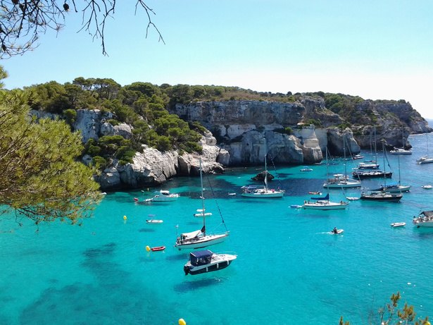
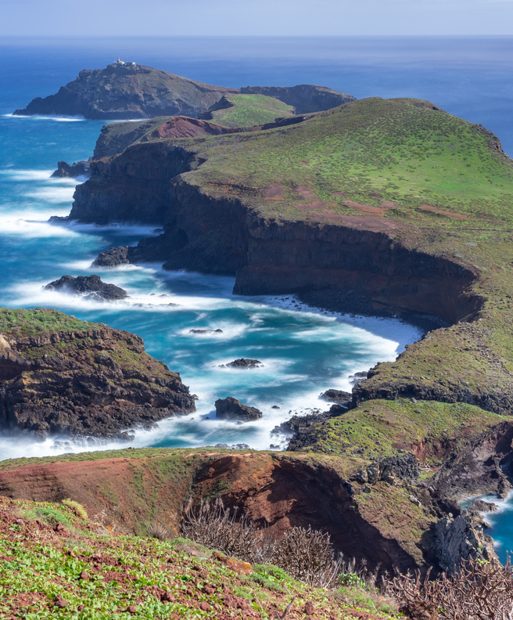
Future Roadmap
Share wishlists or itineraries with friends.
Collaborative planning: allow others to pin suggestions.
Auto-generate itineraries based on pins + trip duration.
Get directions integrated with Google Maps.

Slide 14


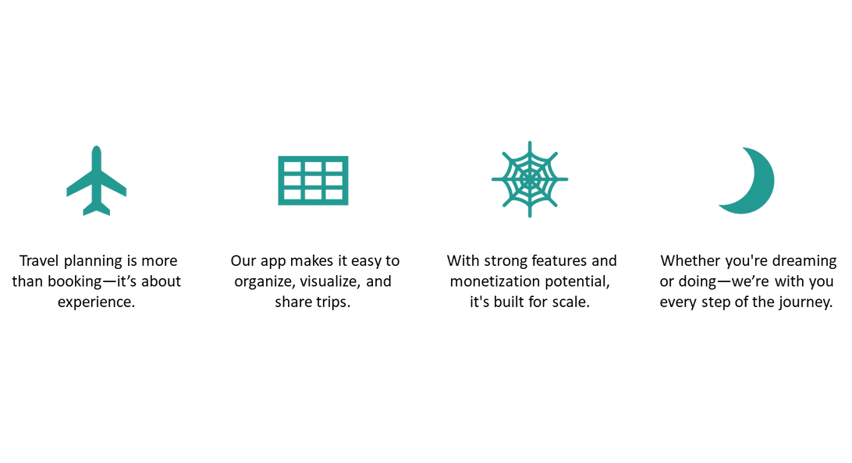
Conclusion

